Slide 1
GO Team Meeting #2
Where we are – Where we’re going

Slide 2
Where We Are
Our strategic plan is the guide for the work we’re doing in the school. By monitoring the plan and ranking priorities, we can all work towards the common goals. Using the priorities in the strategic plan, the school leadership team developed a Continuous Improvement Plan (CIP) for the current school year.

Slide 3
Timeline for GO Teams
You are HERE
Fall 2021
GO Team Developed 2021-2025 Strategic Plan
1
Summer 2022
School Leadership completed Needs Assessment and defined overarching needs for SY22-23
2
August 2022
School Leadership completed 2022-2023 Continuous Improvement Plan
3
Sept. – Dec. 2022
Utilizing current data, the GO Team will review & possibly update the school strategic priorities and plan
4
Before Winter Break
GO Team will take action (vote) on the rank of the strategic plan priorities for SY23-24 in preparation for budget discussions.
5

Slide 4
Discussion Items
Current Strategic Plan
Continuous Improvement Plan
Needs Assessment
SMART GOALS
Monitoring Measures
MAP Data
Data Protocol

Slide 5
Current Strategic Plan
2021-2025

Slide 6
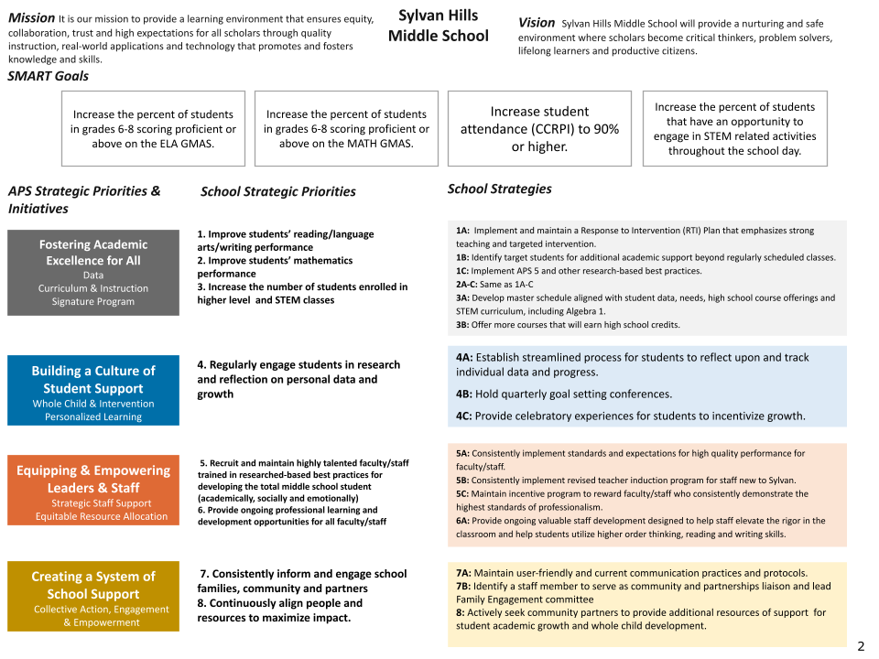
14

Slide 7
Continuous Improvement Plan
SY 2022-2023

Slide 8
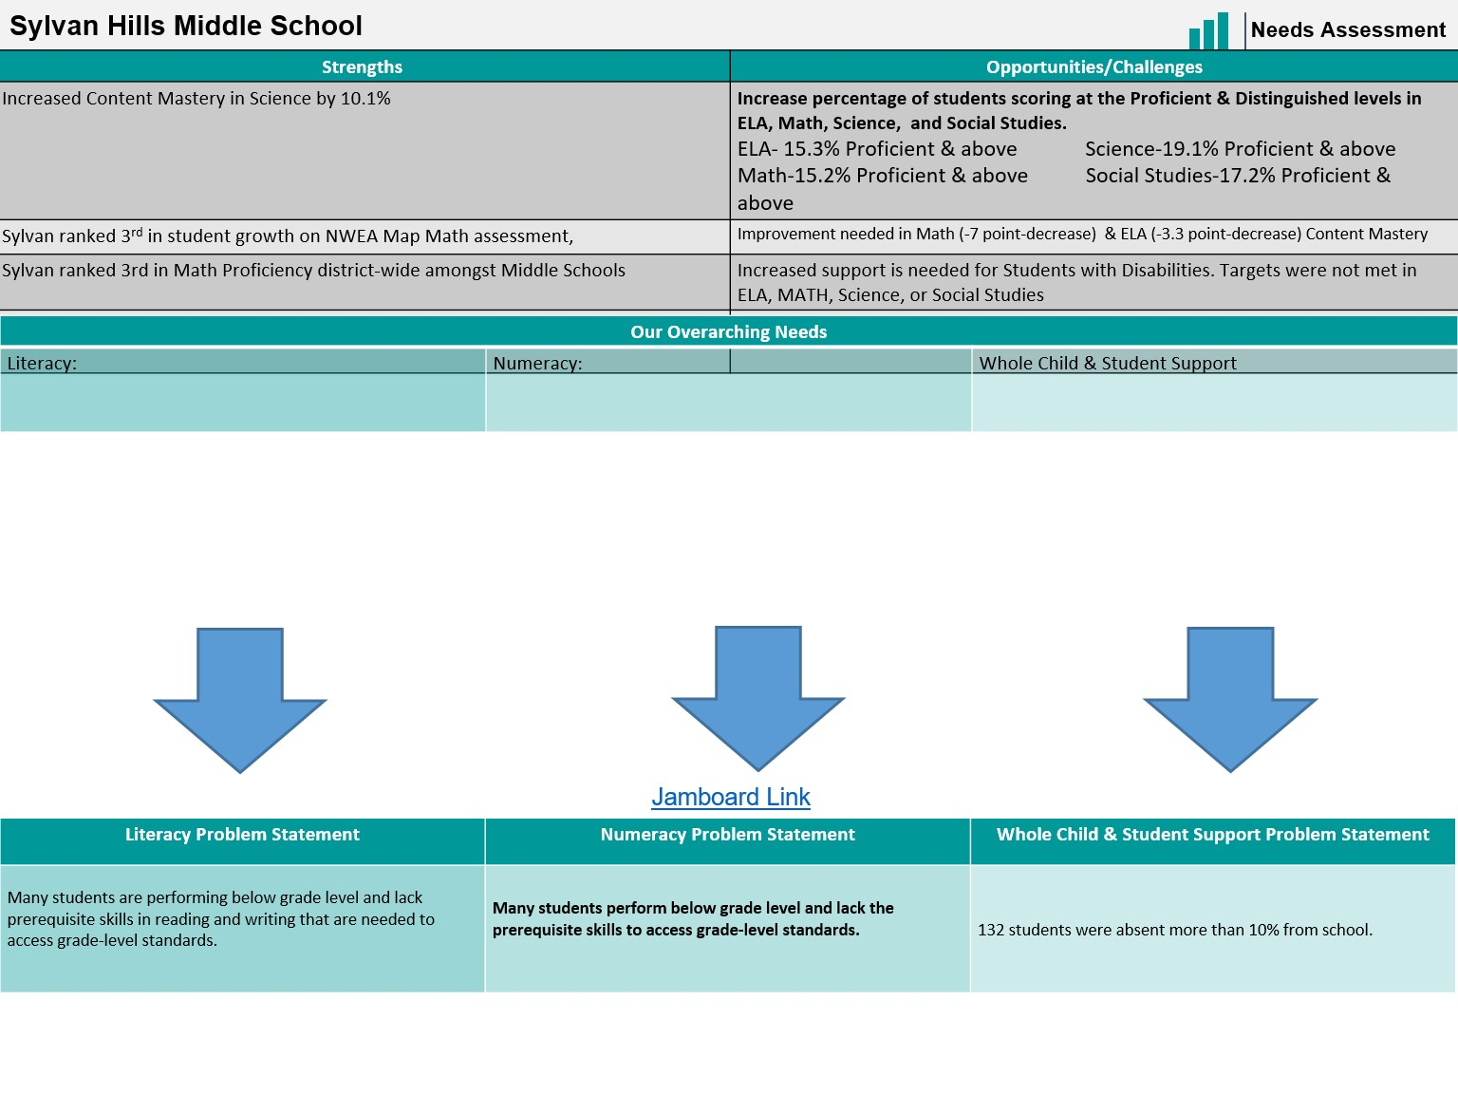
Notes:
Notes for School CIP Teams: After completing your Comprehensive Needs Assessment ( data protocol), you will come here and identify some strengths and opportunities/challenges you have observed from the data. The priority areas are Literacy, Numeracy, and Whole Child & Student Support. Identify an overarching need for each area. Formulate a problem statement for each area. Make sure the problem statement meets the criteria. Refer to your CIP resources.

Slide 9
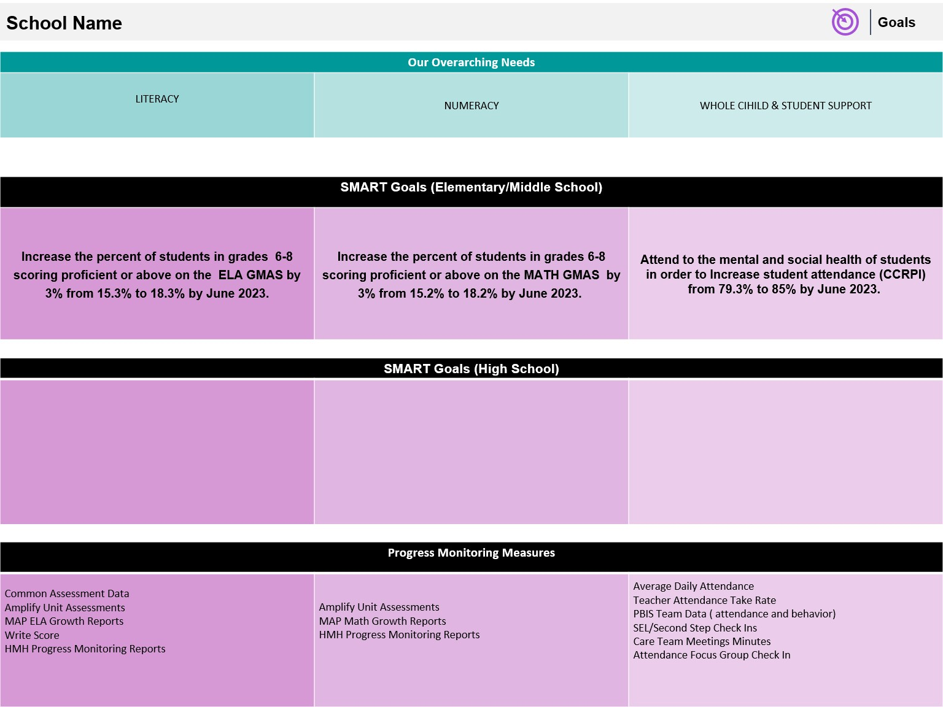

Slide 10
Our Current Progress Monitoring Measures
Literacy
Numeracy
Whole Child
Classroom observations
Assessment data
Professional learning
Coaching Cycles
Classroom observations
Assessment data
Professional learning
Coaching Cycles
BASC-3 BESS Screener results
PBIS
Attendance rate

Slide 11
MAPS Data
1st Administration

Slide 12
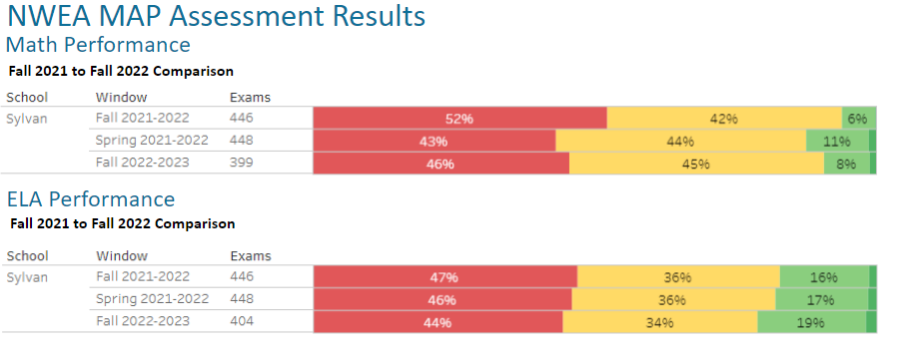

Slide 13
GO Team Discussion: Data Protocol
What do you notice?
What are your wonderings?
What additional questions do you have?

Slide 14
Strategic planning will help you fully uncover your available options, set priorities for them, and define the methods to achieve them.
Robert J. Mckain

Slide 15
Where we’re going
At our next meeting(s) we will discuss how our data is aligning to our strategic plan and determine if we need to make any adjustments.
Before the end of Fall Semester, we will take Action (vote) on ranking our strategic priorities for the 2023-2024 school year.
Let me or the Chair know of any additional information you need for our future discussion.

Slide 16
Thank you

